Slide 1


Driver Monitoring System Real-Time Driver Alertness and Drowsiness Monitoring Using Facial Landmarks
Presented by:-
Rani Uddarsh
MTech Automotive Technology 25070152008

Slide 2
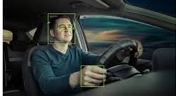
Driver Monitoring System (DMS)
A Driver Monitoring System is an intelligent in-cabin safety system built to continuously monitor the driver’s behaviour and psychological conditions to detect any fatigue, distraction or reduced alertness.
Purpose:
Improve Driver Safety.
Reduce fatigue related accidents .
Provide early warning before unsafe driving occurs.

Slide 3
Why DMS is required?
Major causes of Road accidents:
Driver Fatigue.
Distraction .
Delayed Reaction Time due to Non attentiveness.
Mobile Phone Usage.
Need for DMS: Early Identification of unsafe driver behaviour prevents accidents
Modern vehicles use DMS as a part of active safety systems.

Slide 4
Basic Components of DMS
Hardware Components:
Camera.
Processing system.
Audio Warning unit.
Software Components:
Python
OpenCV
Mediapipe
Output:
Visual Warning
Audio Alert
Event Recording

Slide 5
Basic Working Principle of DMS
Working Flow
Driver Face
Camera Input
Facial Landmark Detection
Driver State Analysis
Warning Generation

Slide 6
Facial Landmark Detection
Face Mesh Concept
Mediapipe Face Mesh provides 468 facial landmarks.
Important Regions used
Eyes
Mouth
Nose
Why Landmarks?
They allow geometric analysis of driver facial movement.

Slide 7
Eye Landmark References Used
Left Eye Landmarks:
33, 160, 158, 133, 153, 144
Landmark Meaning:
33 and 133 → Eye Corners
160 and 158 → Upper Eyelid
153 and 144 → Lower Eyelid
These points are used to calculate eye opening and closing.
Similar to left eye landmarks, there will be specific landmarks for right eye as well.

Slide 8

Eye Aspect Ratio (EAR)
EAR is a geometric ratio used to measure eye opening and closing.
Formula to Calculate EAR:
EAR = $\frac{(\left|\left|p_{2}−p_{6}\right|\right|+\left|\left|p_{3}−p_{5}\right|\right|)}{2|\left|p_{1}−p_{4}\right||}$
Where, p_{1,2,3,…..6} are the eye landmark points.
Lower the EAR value, that closed is the eyelid.

Slide 9
EAR Threshold Values referred
Driver State Thresholds
Single blink is ignored by using frame-based decision logic.
Driver State | EAR Range
Alert | 0.25 – 0.35
Mild Drowsiness | 0.21 – 0.24
Heavy Drowsiness | < 0.20

Slide 10
Multi-Level Drowsiness Detection
Logic Used:
15 continuous frames → Mild Drowsiness
30 continuous frames → Heavy Drowsiness
Frame counting avoids false detection during normal blinking.

Slide 11
Head Position Detection
Nose Landmark is used for head position estimation
Head states:
Looking left
Looking right
Looking down
Center
Head position detection helps detect distraction behaviour.

Slide 12
Yawning Detection
Here, the yawning detection is based on the measuring of the distance between upper lip and lower lip.
Larger distance between lips indicates yawning.
Yawning can be categorized under fatigue indicator.

Slide 13
Phone Distraction Detection
Continuous downward head position indicates possible phone distraction.
This can cause serious accidents due to the negligence of the driver.
It can be categorized under driver negligence only. Cannot be considered to be a fatigue symptom.

Slide 14
Audio Warning Strategy
Two audio levels are used to alert the driver indicating different severity levels.
Mild alert sound to indicate mild drowsiness.
Heavy alert sound to indicate heavy drowsiness.

Slide 15
Proposed Model Architecture
Camera Input
Face Mesh Detection
EAR + Mouth + Nose Analysis
Decision Logic
Audio Warning

Slide 16
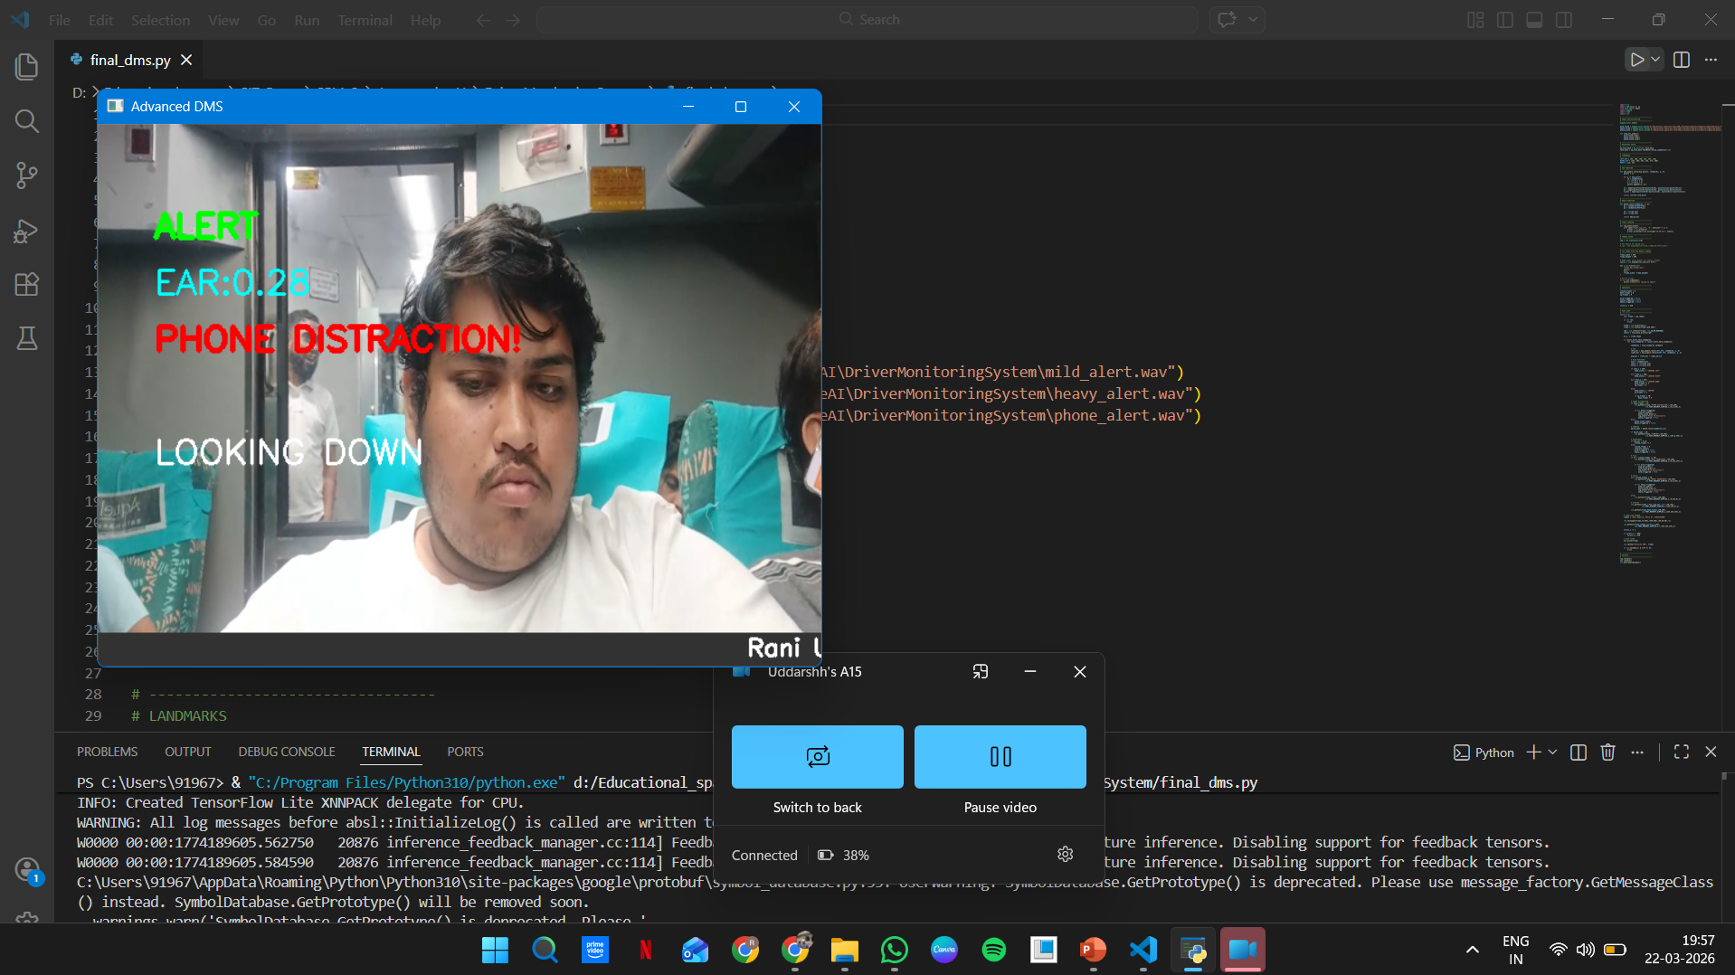
Features Implemented in My Model
Implemented Features:
Alertness detection
Mild Drowsiness detection
Heavy Drowsiness detection
Head position monitoring
Yawning detection
Phone distraction warning

Slide 17
Advantages of Proposed Model
Advantages:
Low-Cost.
Real-time operation.
Easy implementation.
Scalable to automotive industry level.

Slide 18
Future Scope
Exact head-angle estimation
Object-based phone detection
Gaze tracking

Slide 19
Conclusion
The proposed DMS continuously monitors driver psychological and behavioural indicators and generates progressive warnings to improve active safety.
This Prototype demonstrates practical driver fatigue detection using computer vision.

Slide 20
THANK YOU Q&A

